Slide 1
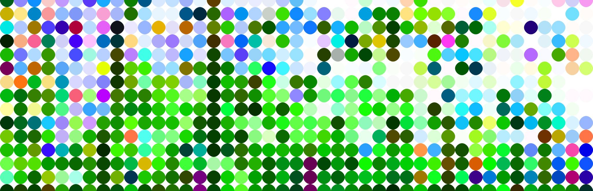
Regulatory Science, Statistics, Innovation, And Education Models
Robert T. O’Neill Ph.D.

Slide 2
Disclaimer While I will consider and discuss issues of regulatory importance, I am retired from FDA and have no official relationship with FDA – these are my own positions

Slide 3
Outline of talk topics
Motivation for this talk
Regulatory Science – what is it
Evidence generation to meet regulatory standards
Innovation – current environment, expressed in regulatory guidance – Covid impact
Biostatistics- clinical trials, methods , applications, course content and use of real examples in pharmaceutical development
Education / training models
Harvard Course
European Course in Pharmaceutical Medicine (ECPM)
What others recognize as a need for academic training in regulatory science
Concluding remarks

Slide 4
Motivation for this talk
The statistical framework underlying drug development and drug regulation is increasingly more complex and fundamental to providing critical evidence for product approval, for efficient trial and program planning, monitoring, safety assessment, data access and integration for decision making
‘Substantial evidence ‘ of efficacy and safety relies on randomized controlled trials and the statistical principles underlying their design, analysis and interpretation – many regulatory guidances now
Regulatory science is a mature body of content, continuously evolving, yet not taught in the university or medical school setting, and many in the industry are ill informed about key aspects that would mitigate failures in development
With innovation being the modern mantra for pharmaceutical development and science, there needs to be new ways of translating regulatory science into training and education models, and team collaboration in the pharmaceutical development and regulatory space – a culture change

Slide 5
How and when did this culture change begin ? In 2004 with FDA’s Critical Path Initiative
The Critical Path Initiative (CPI) is FDA's national strategy for transforming the way FDA-regulated medical products are developed, evaluated, and manufactured.
The Initiative was launched in March 2004, with the release of FDA's landmark report Innovation/Stagnation: Challenge and Opportunity on the Critical Path to New Medical Products.
The publication diagnosed the reasons for the widening gap between scientific discoveries that have unlocked the potential to prevent and cure some of today's biggest killers, such as diabetes, cancer, and Alzheimer's, and their translation into innovative medical treatments.
Sounding the alarm on the increasing difficulty and unpredictability of medical product development, the report concluded that collective action was needed to modernize scientific and technical tools as well as harness information technology to evaluate and predict the safety, effectiveness, and manufacturability of medical products.

Slide 6
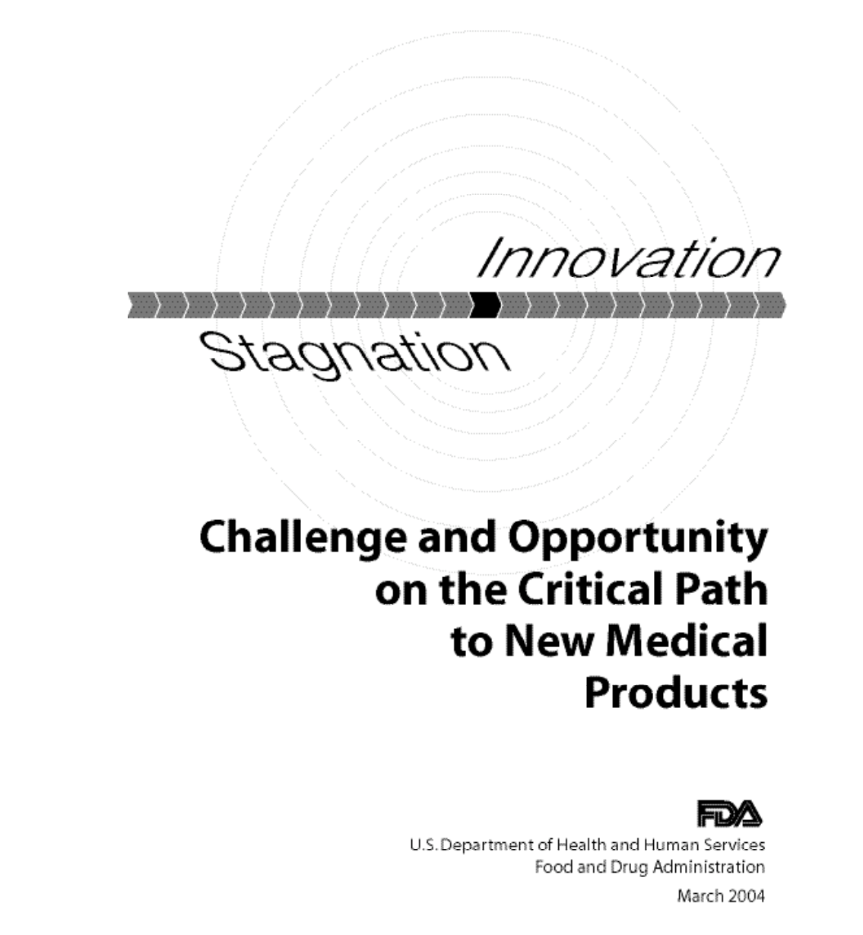
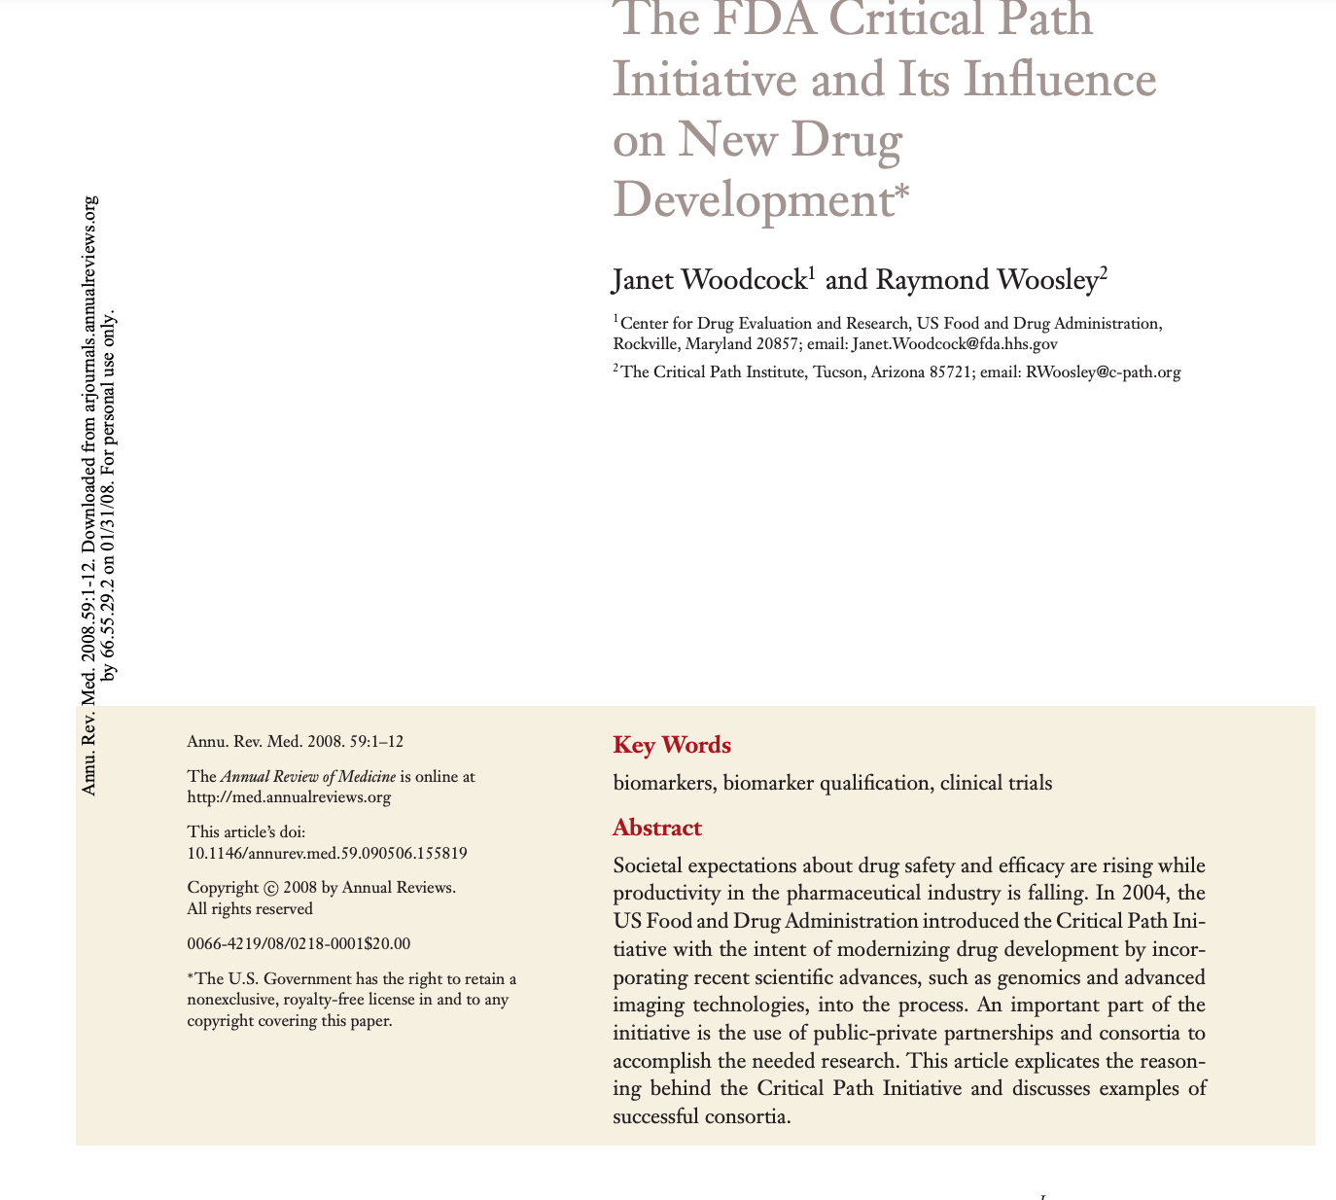

Slide 7
FDA's Critical Path Initiative – the stimulus to get things moving 2004 report, 2006 the List of issues
This initiative triggered many discussions among different stakeholders resulting in the issuance of "Critical Path Report and List" in 2006, which enumerates leading areas for scientific improvement in the development process:
Development and utilization of biomarkers
Modernize clinical trial methodologies and procedures
Enhance the use of bioinformatics, including disease modeling and trial simulation.
Improvement in manufacturing technologies
Consortia involved in clinical path activities

Slide 8
Innovation – many areas of application
Quantitative safety analysis and surveillance
Clinical trial study designs
Enrichment designs
Multi-regional trials
Adaptive ; seamless phase 2/3
Basket, Master protocols
Data collection
Mobile devices, electronic capture, software as a medical device, real world data, Sentinel, OHDSI
Real time central monitoring vs site inspection, updated Good Clinical Practice, Quality by Design
Statistical methodology, ICH E9 update, biomarker qualification, enrichment designs
Biomarker development and qualification

Slide 9
What is Regulatory Science(My definition)
Regulations that establish scientific criteria for efficacy and safety of medical products
Guidances issued by FDA, EMA and the International Council on Harmonization (ICH) containing scientific content and advice
Data from experimental clinical studies used for modeling, meta-analysis, simulations
The science of regulatory (statistical) evaluation of evidence of efficacy and safety whose infrastructure provides guidance, direction and advice, and feedback to the pharmaceutical industry – not achievable with literature peer review process
Case studies – publicly available information (reviews, Advisory Committee meetings) that serve as lessons learned from decision making
Methodology development, new tools to evaluate evidence (qualification, MCP-MOD)
Stimulus for Innovation, constantly evolving with the science

Slide 10
Regulatory Science (FDA definition – see next slide)
Regulatory Science is the science of developing new tools, standards, and approaches to assess the safety, efficacy, quality, and performance of all FDA-regulated products. Knowledge gained from CDER science and research increases the certainty and consistency of regulatory decisions and contributes to the development of regulatory guidance documents and best practice standards for pharmaceutical companies.

Slide 11
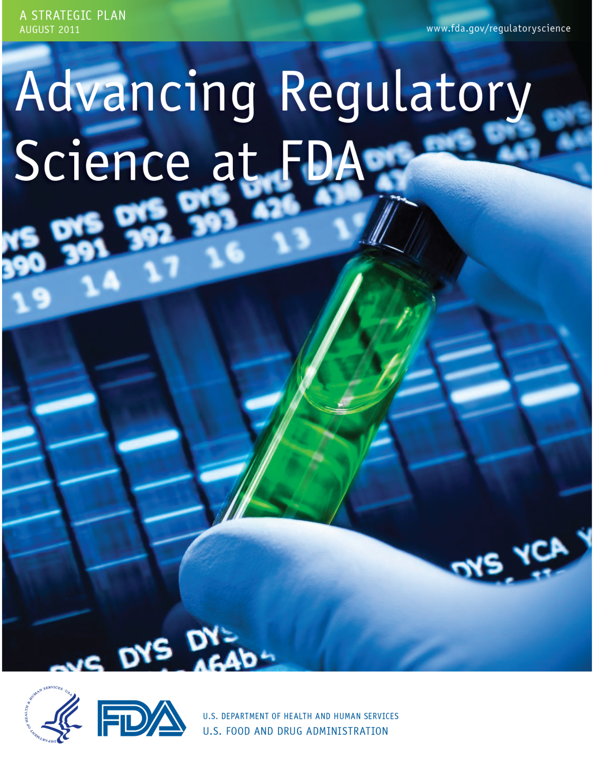
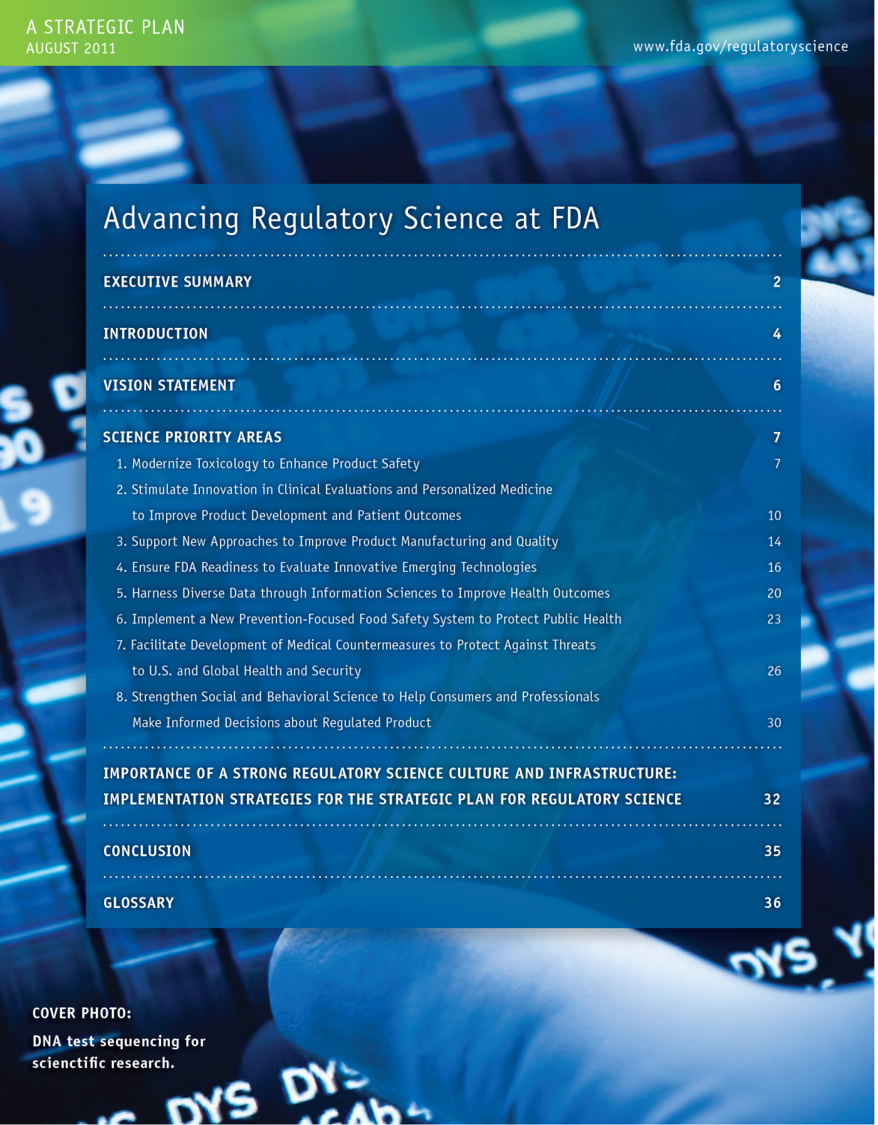

Slide 12
Regulatory Science Framework
FDA describes regulatory science as "the science of developing new tools, standards and approaches to assess the safety, efficacy, quality, and performance of FDA-regulated products”
We will discuss the role of many science-based published guidelines to implement regulations that provide sponsors the strategies to plan study designs, good clinical practice to conduct and monitor studies, appropriate patient safety assessments and data collection and measurement criteria, data standards, storage and quality that will eventually be evaluated by regulators once a product application is submitted for regulatory approval
Despite the importance of regulatory science, there has not been an effort in training for this field in the academic space. As a result, scientists working in this field, whether as a regulator, academic or in the pharmaceutical industry, have to learn everything on the job

Slide 13
A core component of regulatory science Case studies of FDA Advisory Committees evaluating substantial evidence of efficacy (and safety), risk / benefit assessments, study design discussions
Those occurring on White Oak campus are webcast , archived and available under Adobe Connect; more recent meetings are on You Tube (eg COVID 19 vaccine meetings)
Contains industry and FDA slide presentations, briefing packages, minutes, voting results if held and video
Numerous examples used in the Harvard School of Public Health course and described in the published article in Chance
See later slides on this topic

Slide 14
A core component of regulatory science; Scientific content in guidances
There are extensive Regulatory Guidances on multiple topics of relevance to clinical trials, disease specific study approaches, good clinical practice and quality assurance, safety assessment
FDA, European and Japanese regulatory guidances;
ICH guidances

Slide 15
1. Recently issued regulatory guidances with substantial statistical content (FDA & ICH)
Adjusting for Covariates in Randomized Clinical Trials for Drugs and Biological Products (Draft) ; May 2021
Adaptive Design Clinical Trials for Drugs and Biologic, Guidance for Industry ;December 2019
Multiple Endpoints in Clinical Trials ;January 2017
E9(R1) Statistical Principles for Clinical Trials: Addendum: Estimands and Sensitivity Analysis in Clinical Trials, Guidance for Industry; May 2021
Meta-Analyses of Randomized Controlled Clinical Trials to Evaluate the Safety of Human Drugs or Biological Products, Guidance for Industry (Draft); November 2018
E17 General Principles for Planning and Design of Multiregional Clinical Trials, Guidance for Industry; July 2018

Slide 16
2. Recently issued regulatory guidances with substantial statistical content (FDA & ICH)
E16 Biomarkers Related to Drug or Biotechnology Product Development: Context, Structure, and Format of Qualification Submissions ; August 2011
Qualification Process for Drug Development Tools, Guidance for Industry and FDA Staff ; November 2020 (statistical approach known as MCP-MOD qualified by EMA and FDA - combines dose response estimation with multiple comparison control)
COVID-19: Master Protocols Evaluating Drugs and Biological Products for Treatment or Prevention, Guidance for Industry ; May 2021 (umbrella trials, basket trials)

Slide 17
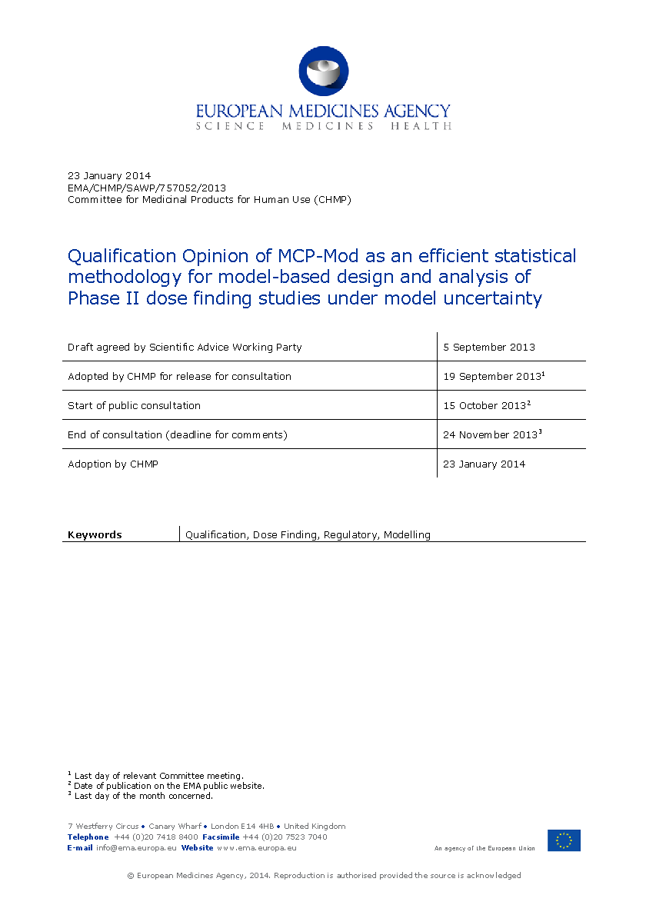
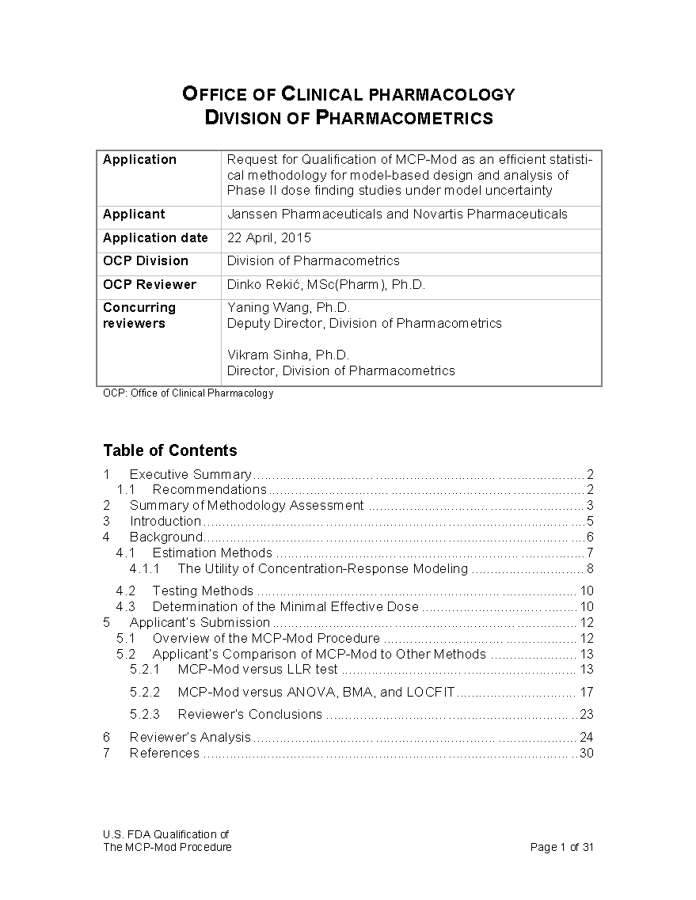
Regulatory qualification of a statistical method ; FDA and EMA

Slide 18
3. Recently issued regulatory guidances with substantial statistical content (FDA & ICH)
Interacting with the FDA on Complex Innovative Trial Designs for Drugs and Biological Procucts, Guidance for Industry ; December 2020
E6(R2) Good Clinical Practice : Integrated Addendum to ICH E6(R1) ; March 2018
FDA Guidance on Conduct of Clinical Trials of Medical Products During the COVID-19 Public Health Emergency, Guidance for Industry, Investigators, and Institutional Review Boards ; August 2021
Statistical Considerations for Clinical Trials During the COVID-19 Public Health Emergency Guidance for Industry, Guidance for Industry ; June 2020

Slide 19
Evidence flexibility to accommodate generation of evidence for rare diseases, gene / cell therapy, companion diagnostics
‘Demonstrating Substantial Evidence of Effectiveness for Human Drug and Biological Products’ : This is new and updated
FDA guidance that provides extensive details and examples for the quantity and quality of evidence required. It covers the types of evidence, the quantity (number of studies) of evidence , the quality of the evidence and the areas of flexibility to accommodate the study of rare diseases, serious diseases with no currently available cure, and situations where it may be unethical or not feasible to conduct a trial.
Four FDA guidances on rare diseases, natural history studies, diagnostic co-development

Slide 20
https://www.fda.gov/regulatory-information/search-fda-guidance-documents/clinical-trials-guidance-documents FDA website for guidance documents:
Rare Diseases: Common Issues in Drug Development Guidance for Industry
Rare Diseases: Natural History Studies for Drug Development Guidance for Industry (Draft)
Human Gene Therapy for Rare Diseases , Guidance for Industry
Considerations for the Design of Early-Phase Clinical Trials of Cellular and Gene Therapy Product
Principles for Codevelopment of an In Vitro Companion Diagnostic Device with a Therapeutic Product.
Webinar Slides - Draft Guidance on “Principles for Codevelopment of an In Vitro Companion Diagnostic Device with a Therapeutic Product" (PDF - 252KB)

Slide 21
- Electronic source data; electronic application format; data standards for clinical trials FDA Guidance Documents on these topics
https://www.fda.gov/regulatory-information/search-fda-guidance-documents/clinical-trials-guidance-documents
https://www.fda.gov/regulatory-information/search-fda-guidance-documents/providing-regulatory-submissions-electronic-format-certain-human-pharmaceutical-product-applications
https://www.fda.gov/drugs/electronic-regulatory-submission-and-review/cder-data-standards-program
https://www.fda.gov/regulatory-information/search-fda-guidance-documents/electronic-source-data-clinical-investigations

Slide 22
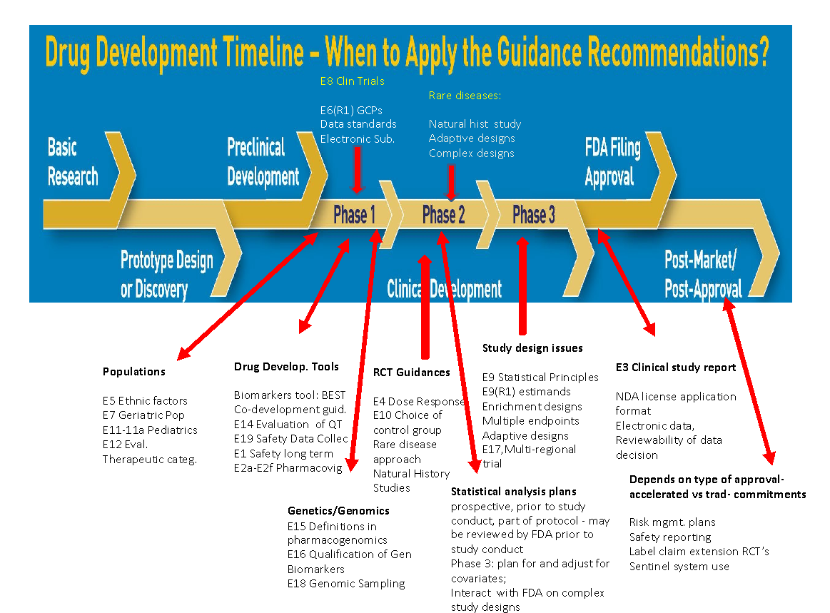
Below illustrates where these multiple guidances are relevant to different stages and times in development ; the figure below does not exhaust all relevant guidance

Slide 23
As development becomes more complex, and guidances are issued to deal with the complexity, the academic world is unaware
Scientists and clinicians entering the pharmaceutical industry and regulatory enterprise mostly come from the academic community
Most in the academic community are unaware of basic regulatory standards of evidence or how it is developed, evaluated, monitored, audited and the rigor required of the team to plan, conduct, analyze and interpret experimental evidence
Usually, it is a learn on the job exercise – increasingly inefficient
So, how do we shrink the learning curve

Slide 24
Is it time to incorporate more regulatory science content in curricula, including biostatistics’ departments – what content ?
Real current examples of evidence generation and evaluation based upon clinical study designs, observational studies, meta-analyses, external data sources requiring modeling, propensity score matching, causal analysis thinking, missing data and estimand/sensitivity approaches
Regulatory Guidances described in earlier slides
Case studies in the public domain – all on FDA’s websites as discussed earlier
Documentation of regulatory approval decisions, advisory committee meetings and other content publically available on FDA’s website: Drugs@FDA

Slide 25
Why raise this now ? It’s about time !
Statistical issues involved in pharmaceutical development and fundamental to success and efficiency of programs to bring safe and effective therapies to patients
Most statisticians are not exposed to these issues in their training , currently
Most clinicians who come from an academic program, who become academic investigators , or are then involved in IND studies are unaware of most of the core regulatory criteria and rigor required as well as the core statistical concepts needed in modern clinical research to support evidence generation.
The academic clinical investigator is trained for a different role – and to publish
Considerable concern for inefficiencies in drug development and failures that might be avoided or minimized if better informed

Slide 26
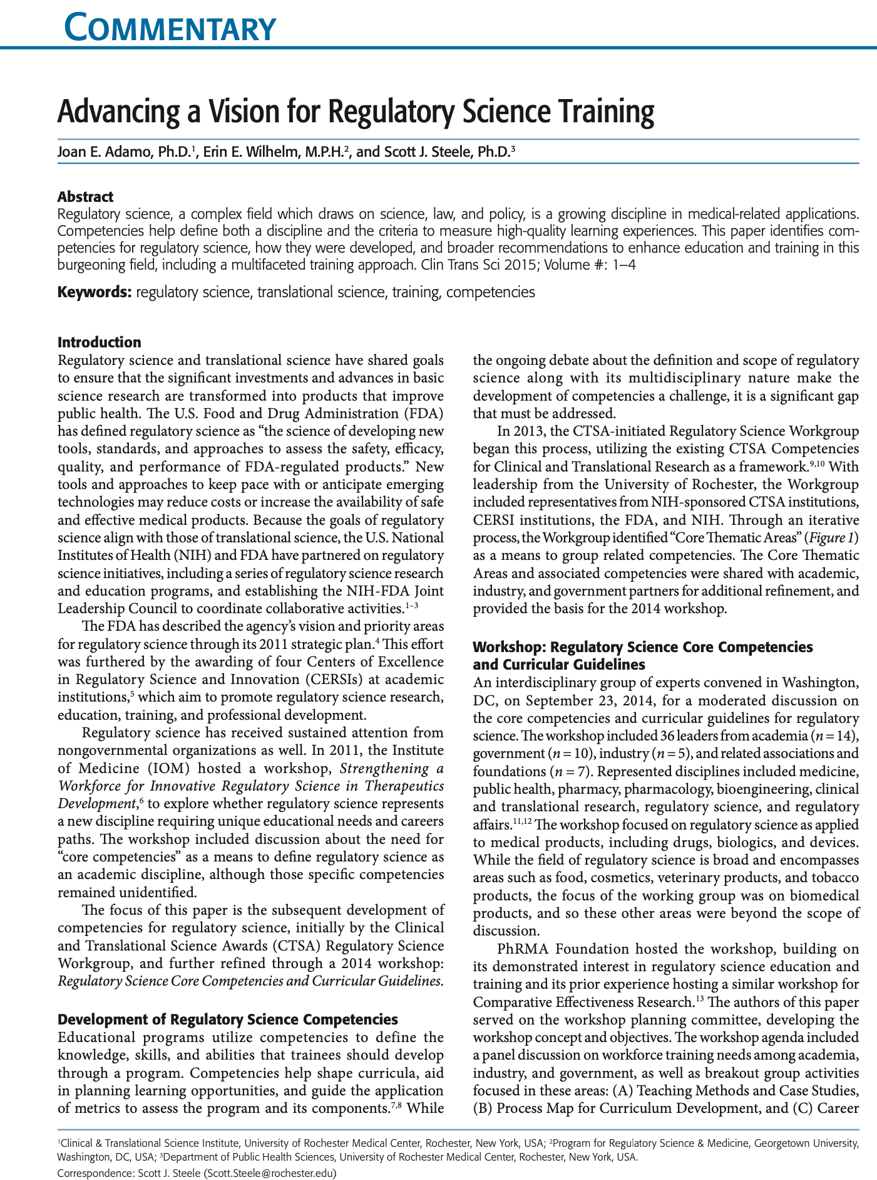
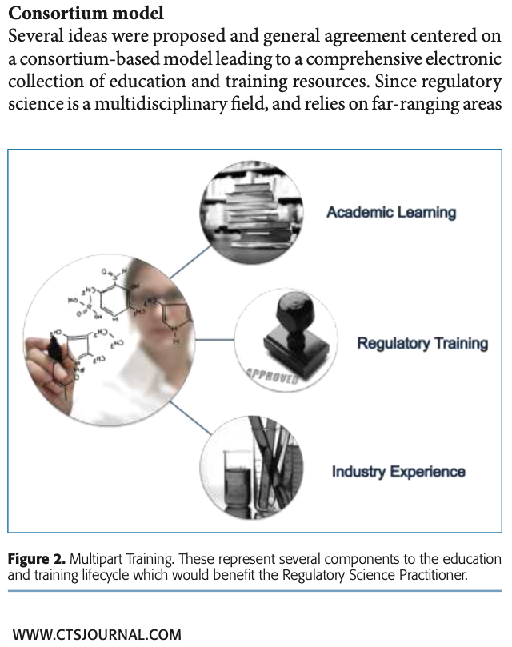

Slide 27
A Brief Summary of my ECPM life experience (European Course in Pharmaceutical Medicine)
1989, moved to Basel, Switzerland on a FDA sabbatical at University of Basel to observe European regulatory efforts in guidelines for clinical trials and drug development – this was 1 year before ICH was created and began working parties
At that time, no regulatory statistical expertise in the UK, France, Germany and most other EU countries – one reason why I was there to influence a change in that attitude and make the statistical community a full partner and contributor to future European approach
Created biweekly 2 hour lecture series on statistical aspects of drug evaluation at Univ. of Basel, Dept of Research (Dir. Fritz Buhler)
Over 400 attendees from Switzerland, France, UK and Germany
ECPM created to continue course, now 30 years later, well over 2500 graduates
Website: ecpm.unibas.ch

Slide 28
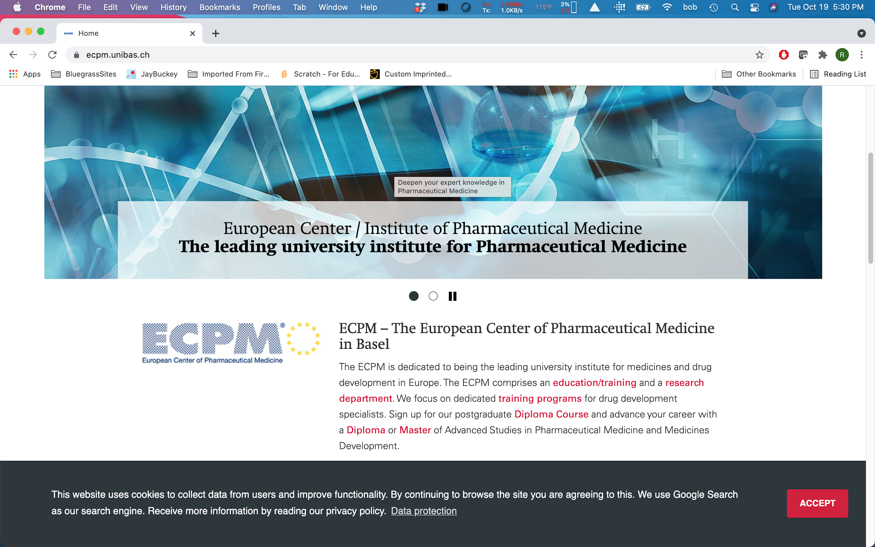

Slide 29
My attempt to promote this idea in an academic setting in Boston @ Harvard School of Public Health
Spring course taught for 4 years at the Harvard School of Public Health titled ‘Quantitative Methods in the Evaluation of Evidence ‘
Co-taught with Dr. Marci Testa
Published article in Chance Magazine describes approach , content, case studies, how to access and utilize content available on FDA’s website

Slide 30
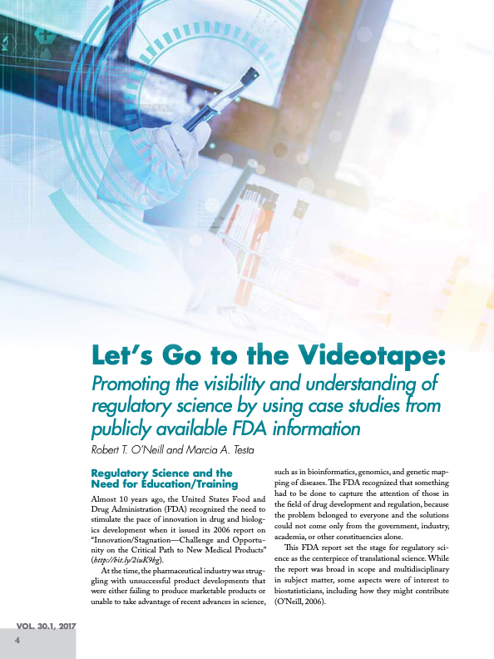
Published in Chance Magazine
V 30.1, 2017
Based on 4 years experience with a spring course at Harvard School of Public Health

Slide 31
KEY TAKE AWAYS FROM THIS COURSE (1)
Multidisciplinary student graduate/post graduate population – may be too early in their career to fully absorb material
What is optimal in class vs out of class exposure to content and videos
Covid 19 Zoom experience opens new ideas for collaborations and team experience
FDA advisory committee videos are powerful tool to illustrate decision making and evidence evaluation , outside academic approaches (eg NIH application review, peer review process, traditional academic course work and applications)
Regulatory science contains a huge amount of material relevant to pharmaceutical scientist and it dynamically changes over time
Currently, I am unaware of academic curricula embracing aspects of regulatory science – Not regulatory affairs which is a different focus and content

Slide 32
ECPM and the HSPH course provides a foundation for what new educational models might be – how to launch
PhRMA had a training center at one time - lost their purpose
Biopharm section of ASA is very active
DIA webinars very useful
NIH CTSA network is a possibility but difficult to engage
Department of Biostatistics – coordinated networks ?

Slide 33
What is happening in Europe, who has actually recognized the need for new ways to bring the academic community into the regulatory science field Funding mechanisms and coordinated initiatives

Slide 34
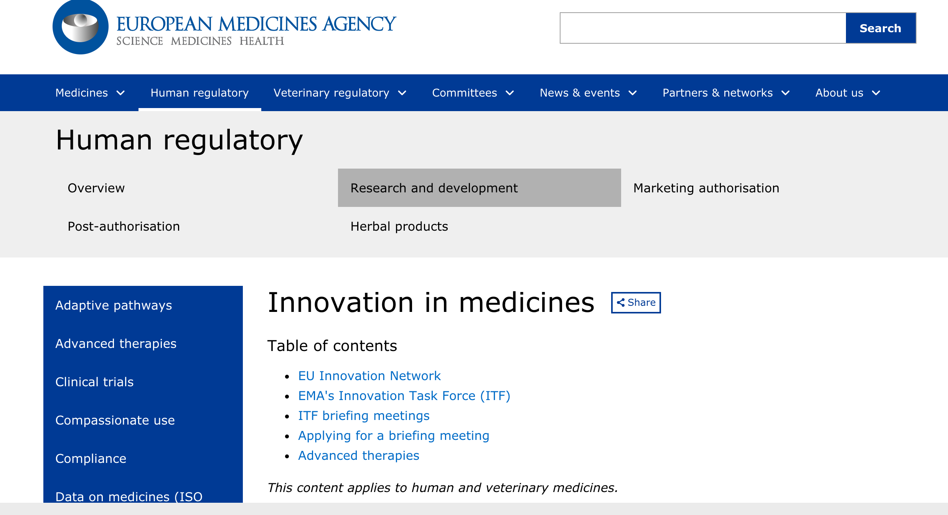
https://www.ema.europa.eu/en/human-regulatory/research-development/innovation-medicines

Slide 35
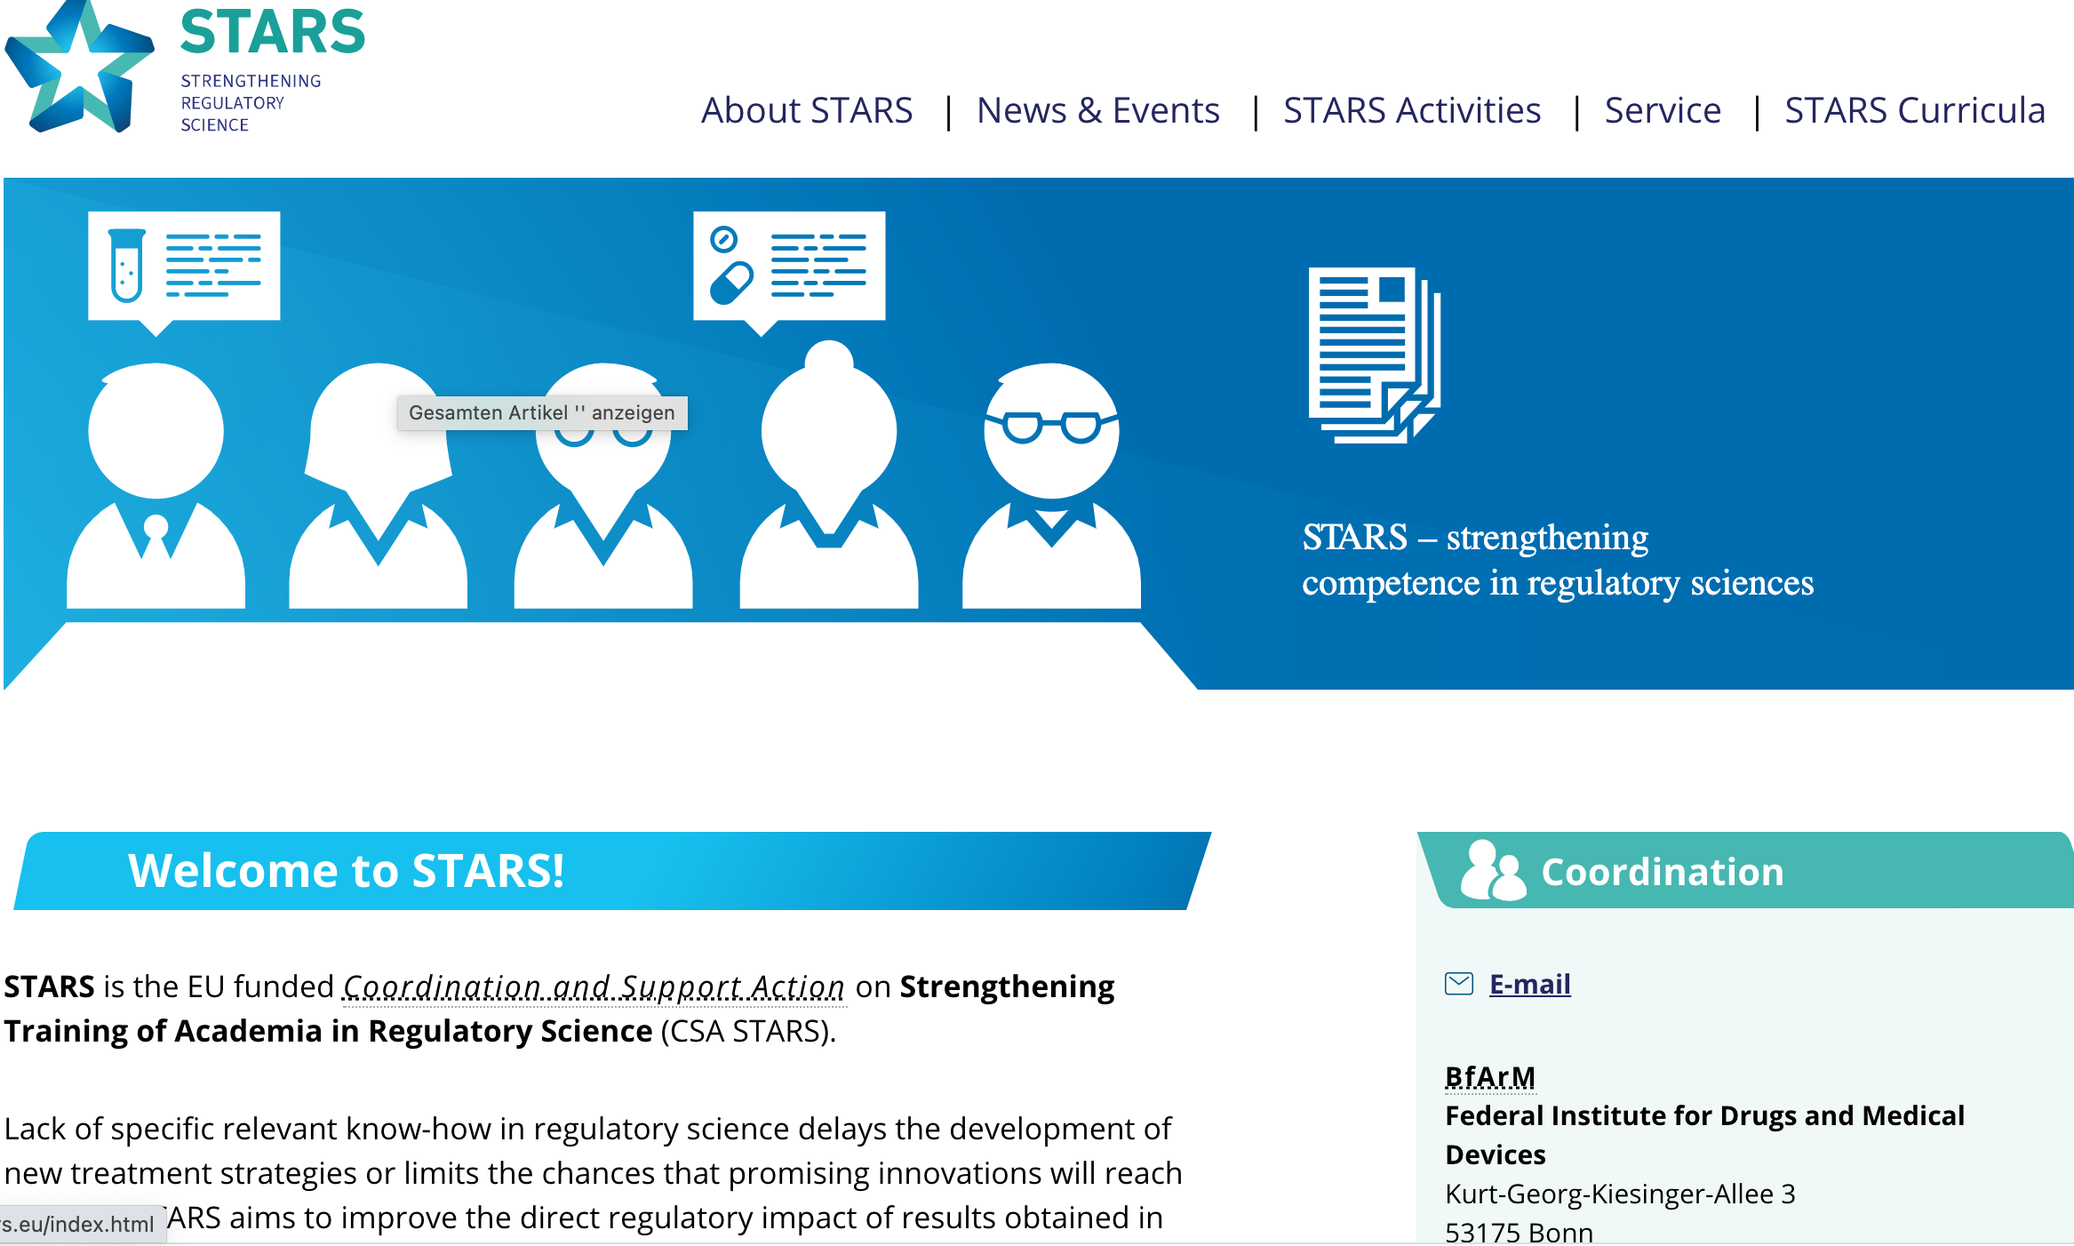
Strengthening Training of Academia in Regulatory Science (STARS) csa-stars.eu/index.html

Slide 36
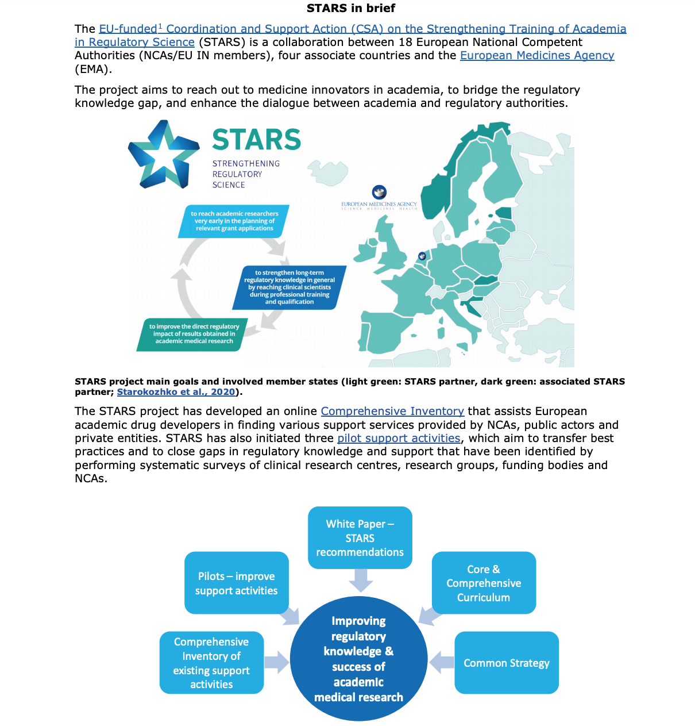

Slide 37
Training to complement discipline specific education and to foster team collaboration
Get Beyond the check box approach in GCP training
Concepts embedded in the ICH updated guidances E8 and E6(R2) ; Quality by design for clinical trials
The ‘Quality by design’ promotes a culture change in actively identifying in advance risks and planning to manage those risks to a study
Should force the team to stress test the assumptions of clinical trial designs in advance of their conduct, including scenario planning, simulations
Who leads the stress test exercises – My position is that experienced statisticians are well positioned to do so

Slide 38
Publically available regulatory information, forming content of regulatory science, that could be incorporated into a learning model
FDA website for guidance documents:
https://www.fda.gov/regulatory-information/search-fda-guidance-documents/clinical-trials-guidance-documents
FDA website for documentation of review decisions and discipline specific evaluations:
Drugs @FDA: https://www.fda.gov/drugs/drug-approvals-and-databases/about-drugsfda
FDA website for publically available webcasts of most advisory committees:
https://www.fda.gov/advisory-committees/committees-and-meeting-materials/human-drug-advisory-committees
ICH website : https://www.ich.org/
EMA website : https://www.ema.europa.eu/en/medicines

Slide 39

Update on COVID-19 lessons learned, progress, new initiatives, collaborations and recommendations to be ready for new pandemic https://reaganudall.org/news-and-events/events/virtual-public-workshop-covid-19-lessons-learned-clinical-evaluation?eType=EmailBlastContent&eId=ec641574-f962-4687-b4d2-27ab351dbf6e

Slide 40
Innovation to meet the challenges of pandemics - lessons learned from Covid-19
I believe there is and will be a huge culture change in the need for and the value of collaboration to develop effective therapies to meet critical, time sensitive therapies, just not vaccines
Already a dramatic collaboration in a short period of time – stimulated by a crisis – that’s the way it usually happens – see the next slide
The learning health system is here – but our infrastructure is not yet ready for it
What does it mean for you, biostatistics, academic models of teaching, reality checking for speed and efficiency, methodologies and real world case studies
Much of my talk would have been about some new ideas but the COVID-19 experience has just made them more relevant – but how do we all respond

Slide 41
Concluding remarks
There is an opportunity for new learning models and regulatory science content to be introduced to the scientific and clinical community who eventually enter pharmaceutical development and regulation
Moving the needle to get there will not be easy without a commitment
Statistical leadership is important and critical to that happening
Experienced statisticians are good candidates to move the needle, lead teams, illustrate the value to prospective planning, simulations, and show how all the content available in the public regulatory space fits together and is integrated

